Slide 1
Introduction To Compiler
Course Code: CSC 3220
Course Title: Compiler Design
Dept. of Computer Science
Faculty of Science and Technology
Lecturer No: | 3 | Week No: | 3 | Semester: | Summer23-24
Lecturer: | Nazia Alfaz, nazia.alfaz@aiub.edu, Room: D0201B

Slide 2
Lecture Outline
Phases of a Compiler
Practice on Different Input Expressions
Linker and Loader
Front end and Back end of a compiler
Symbol Table Management
Error Handler

Slide 3
Objectives and Outcomes
Objectives:
Understand the Structure of a compiler
Understand the tools involved( Scanner generator, Parser generator, etc)
Outcome:
Students will be able to represent the simulation of all phases of a compiler for inputs.

Slide 4
The Phases of a Compiler
Intermediate Code generator: After syntax and semantic analysis of the source program, many compilers generate an explicit low-level or machine-like intermediate representation, which we can think of as a program for an abstract machine. This intermediate representation should have two important properties:
Easy to Produce and
Easy to translate into target program
The intermediate representation can have a variety of forms. In this course we consider an intermediate form called “ three address code”.

Slide 5
The Phases of a Compiler
We need to follow some steps to generate three address code.
Each three address instruction has at most one operator on the right side.
The compiler must generate a temporary name to hold the value computed by each instruction.
Some three address instructions have fewer than three operands.
So the output of the intermediate code generator will be
temp1 := inttofloat(60)
temp2 := id3 * temp1
temp3 := id2 + temp2
id1 := temp3

Slide 6
The Phases of a Compiler
Code Optimizer: The machine-independent code-optimization phase attempts to improve the intermediate code so that better target code will result.
Find More Efficient Ways to Execute Code
Replace Code With More Optimal Statements
Significantly improve the running time of the target program
So this phase optimized the code and produced the output as follows
temp1 := id3 * 60.0
id1 := id2 + temp1

Slide 7
The Phases of a Compiler
Code Generator: The final phase of the compiler is to generate code for a specific machine. In this phase we consider:
memory management
register assignment
The output from this phase is usually assembly language or relocatable machine code.
MOVF R2,id3
MULF R2,#60.0
MOVF R1,id2
ADDF R1, R2
MOVF id1,R1

Slide 8
Reviewing the Entire Process
position := initial + rate * 60
lexical analyzer
(id1) (:= ) (id2) (+) (id3) (*) (60)
syntax analyzer
:=
id1
+
id2
*
id3
60

Slide 9
Reviewing the Entire Process
Semantic analyzer
:=
id1
+
*
id2
id3
inttofloat
60
intermediate code generator
temp1 := inttofloat(60)
temp2 := id3 * temp1
temp3 := id2 + temp2
id1 := temp3

Slide 10
Reviewing the Entire Process
code optimizer
temp1 := id3 * 60.0
id1 := id2 + temp1
code generator
MOVF R2,id3
MULF R2,#60.0
MOVF R1,id2
ADDF R1, R2
MOVF id1,R1

Slide 11
Exercises
Find the output for the following expressions
x=a*b+c-10

Slide 12
A=P-Q/(T*10)+J-W

Slide 13
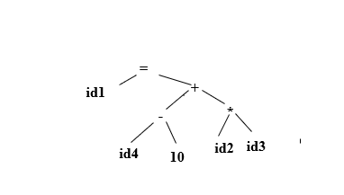
Find the output for the following expressions
x=a*b+c-10
Lexical Analyzer
(id1) (= ) (id2) (*) (id3) (+) (id4) (-) (10)
Syntax Analyzer

Slide 14
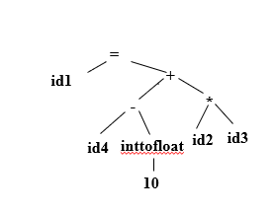
Semantic Analyzer
Intermediate Code Generator
temp1 = id2 * id3
temp2 = inttofloat(10)
temp3 = id4-temp2
temp4 = temp1 + temp3
id1 = temp4

Slide 15
Code Optimizer
temp1 = id2 * id3
temp2 = id4-10.0
id1 = temp1 + temp2
Code Generator
***Do not forget to add symbol table and error handler
MOVF R1,id2
MOVF R2,id3
MULF R1,R2
MOVF R3, id4
SUBF R3, #10.0
ADDF R1, R3
MOVF id1, R1

Slide 16
Linker and Loader
Linker: A linker, also called link editor or binder, is a program that combines the object modules to form an executable program. In general , in case of a large program, programmers prefer to break the code in to smaller modules, as this simplifies the programming task. Eventually, when the source code of all the modules has been converted in to object code, all the modules need to be put together, which is done by the linker

Slide 17
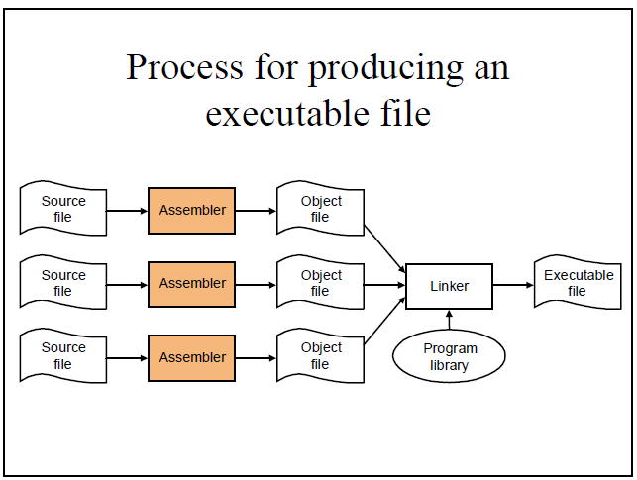

Slide 18
Loader
A loader is a special type of a program that copies programs from a storage device to the main memory, where they can be executed.

Slide 19
Front end and Back end of a Compiler
Front end:
Lexical Analyzer
Syntax Analyzer
Semantic Analyzer
Intermediate Code Generator
Back end :
V. Code Optimizer
VI. Code Generator

Slide 20
Advantages of Using Front-end and Back- end
Retargeting: Build a compiler for a new machine by attaching a new code generator to an existing front-end. By Keeping the same front end & attaching different back ends, one can produce a compiler for same source language on different machines.
Optimization: Reuse intermediate code optimizers in compilers for different languages and different machines. By keeping different front ends and same backend, one can compile several different languages on the same machine

Slide 21
Lecture References
A. Aho, R. Sethi and J. Ullman, Compilers: Principles, Techniques and Tools
(The Dragon Book), [ Second Edition]

Slide 22
References
A. Aho, R. Sethi and J. Ullman, Compilers: Principles, Techniques and Tools(The Dragon Book), [ Second Edition]
Principles of Compiler Design (2nd Revised Edition 2009) A. A. Puntambekar
Basics of Compiler Design Torben Mogensen

